Slide 1
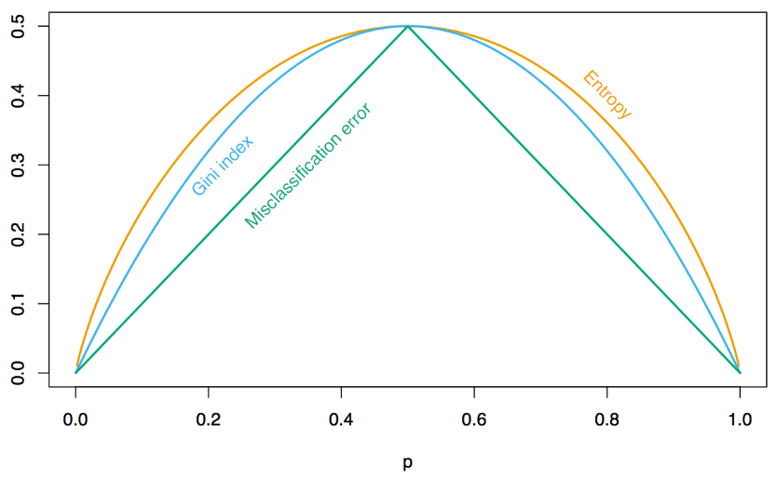
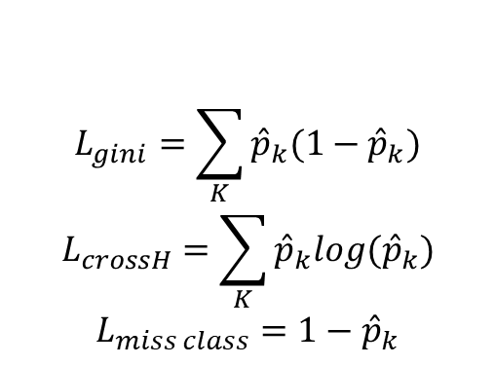
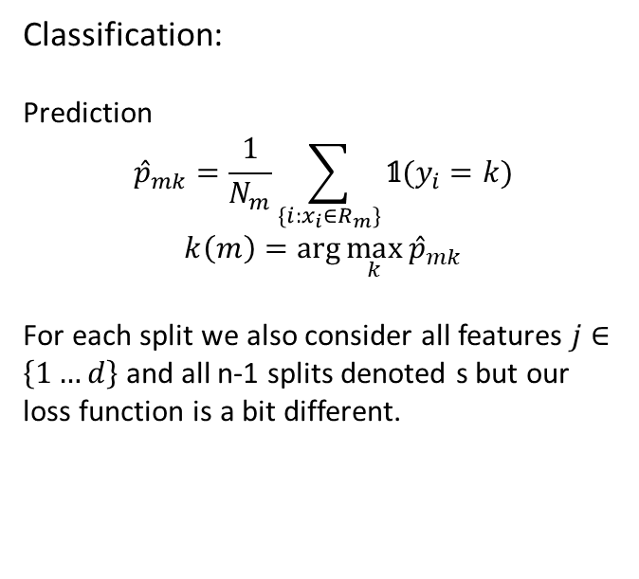
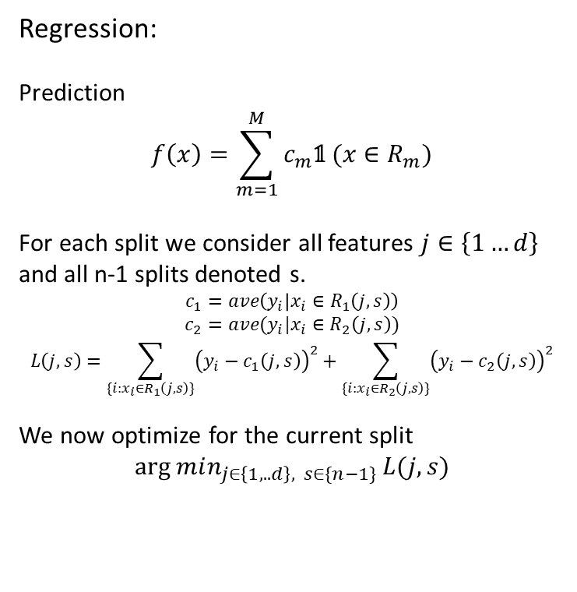
Lecture 5
Trees in general: $\left\{R_{1},…,R_{M}\right\}, where (R_{i}∩R_{j}=Ø∧∀i≠j)∧R_{1}∪…∪R_{M}=X$
NP hard if a greedy approach is not used.
Regression:
Prediction
$$f\left(x\right)=\sum_{m=1}^{M}{c_{m}\text{𝟙} (x∈R_{m})}$$
For each split we consider all features $j∈\left\{1…d\right\}$ and all n-1 splits denoted s.
$$c_{1}=ave\left(y_{i} | x_{i}∈R_{1}\left(j,s\right)\right)$$
$$c_{2}=ave(y_{i}|x_{i}∈R_{2}\left(j,s\right))$$
$$L\left(j,s\right)=\sum_{\{i:x_{i}∈R_{1}\left(j,s\right)\}}{{\left(y_{i}−c_{1}\left(j,s\right)\right)}^{2}+\sum_{\{i:x_{i}∈R_{2}\left(j,s\right)\}}{{\left(y_{i}−c_{2}\left(j,s\right)\right)}^{2}}}$$
We now optimize for the current split
$$arg min_{j∈\left\{1,..d\right\}, s∈\{n−1\}}{L(j,s)}$$
Classification:
Prediction
$${\hat{p}}_{mk}=\frac{1}{N_{m}}\sum_{\{i:x_{i}∈R_{m}\}}{\text{𝟙}(y_{i}=k)}$$
$$k\left(m\right)=\arg{\max_{k}{{\hat{p}}_{mk}}}$$
For each split we also consider all features $j∈\left\{1…d\right\}$ and all n-1 splits denoted s but our loss function is a bit different.
$$L_{gini}=\sum_{K}{{\hat{p}}_{k}(1−{\hat{p}}_{k})}$$
$$L_{crossH}=\sum_{K}{{\hat{p}}_{k}log({\hat{p}}_{k})}$$
$$L_{miss class}=1−{\hat{p}}_{k}$$
Notes:
Gini er konventionen til opbyggelse og miss class er til prune

Slide 2
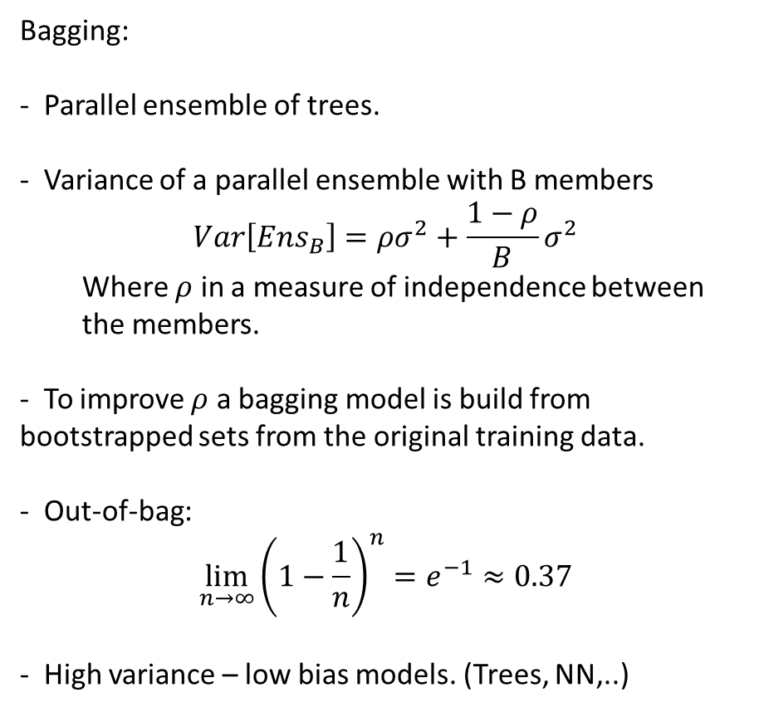
Lecture 5
Bagging:
- Parallel ensemble of trees.
- Variance of a parallel ensemble with B members
$$Var\left[Ens_{B}\right]=ρσ^{2}+\frac{1−ρ}{B}σ^{2}$$
Where $ρ$ in a measure of independence between the members.
- To improve $ρ$ a bagging model is build from bootstrapped sets from the original training data.
- Out-of-bag:
$$\lim_{n→∞}{{\left(1−\frac{1}{n}\right)}^{n}}=e^{−1}≈0.37$$
- High variance – low bias models. (Trees, NN,..)
Pruning:
Build whole tree and remove least important nodes iteratively upwards.
Build by Gini, prune by miss classification
Pro and Cons:
Pros | Cons
Fit non-linear data | Do not extrapolate well
Small trees are interpretable | Do not fit linear diagonal decision boundaries that well
Not sensitive to scale and centering

